Slide 1
C2CPII Material Health Assessor Meeting
April 30, 2024

Slide 2
Agenda
Housekeeping and Introductions
MH Assessor Meeting Purpose and Structure
C2CPII Updates
MH Updates and Reminders
Open Discussion

Slide 3
Housekeeping
Please be aware that this meeting will be recorded for C2CPII internal use.
Questions and comments are welcomed throughout the meeting! Feel free to raise your hand or type your question in the chat.
If you are comfortable turning your camera on, it is highly encouraged!

Slide 4
Introductions
Please share the following:
Name
Role/Position and Organization
Experience conducting C2CC Material Health assessments

Slide 5
Meeting Purpose
Purpose: To increase the quality and consistency of MH assessments and encourage collaboration among MH Assessors.
Address inconsistencies in application submissions
Discuss technical questions and alternate pathways to compliance
Share new chemical classifications, resources, standard interpretations, etc. that will impact all ABs

Slide 6
Meeting Structure
Bimonthly cadence, 1.5 hours
Led by C2CPII with time for open discussion
Topics may include
C2CPII and MH updates
Open technical discussions
Requests for feedback
Assessor-led discussions
Case studies
Seminars/walkthroughs

Slide 7
Meeting Structure
Group discussion: what to do with scheduled quarterly MH calls?
Scheduled for June 6, September 12, December 5
C2CPII Proposal:
Keep June 6, December 5 calls
Remove September 12, replace with August and October calls

Slide 8
Meeting Structure
Group poll (anonymous): Should these call recordings be posted online?
Past recordings were posted on the C2CPII Assessor Resources page and accessible to MHAs and GAs.
Another option is to only share recordings with meeting attendees.
Group poll (anonymous): Are you comfortable with future calls including a representative from each GA?
Historically, these calls have been limited to MH ABs in order to discuss technical areas of MH and utilize MH AB expertise.
However, topics discussed here may also be relevant to GAs.

Slide 9
C2CPII Updates
Version 4.1 Release and Effective Dates
Updated v4.1 RSL Walkthrough (now Restricted Substances Reference Document)
MH Assessment Survey

Slide 10
V4.1 Release and Effective Dates
May 2, 2024: Version 4.1 Publication Date
On this date, the following documents will be published:
V4.1 Standard and reference documents
V4.1 MHC Standard
V4.0 ”sunset” date and updated transition policy
Public comment responses
V4.0 to 4.1 comparison summary document

Slide 11
V4.1 Release and Effective Dates
July 1, 2024: Version 4.1 Effective Date
At this point, applications for the V4.1 standard will be accepted.
On or before this date, the following documents will be published:
V4.1 User Guidance
V4.1 ASF
V4.1 Assessment Forms and Templates
V4.1 Claims Guidance
December 31, 2025: V4.0 Sunset Date

Slide 12
v4.1 Restricted Substances List (now Restricted Substances Reference Document)
With the release of v4.1, the C2CC Restricted Substances List (RSL) has been expanded and re-branded as the Restricted Substances Reference Document.
The document now describes all restricted substances in the Standard, including restrictions from Sections 4.1, 4.2, and 4.6.
4.1: Compliance with Leading Chemical Regulations
4.2: PFAS, HFRs, OPFRs, and Highly Halogenated Materials
4.6: CMRs, SVHCs, and x-assessed chemicals

Slide 13
v4.1 Restricted Substances List (now Restricted Substances Reference Document)
Purpose
To consolidate reference information on substances that are restricted in C2CC products.
To more accurately communicate all C2CC restricted substances at all achievement levels, not just substances restricted in Section 4.1.

Slide 14
v4.1 Restricted Substances List (now Restricted Substances Reference Document)
Walkthrough

Slide 15
MH Assessment Survey
To collect information on which areas of Section 4: Material Health are completed by MH Assessors, and which are completed by GAs.
Purpose:
Helps me to understand which areas of the Standard to focus on during these calls
Provides background information that will help C2CPII determine whether an MHA-specific quality rating would be useful and feasible, in addition to the full ASF quality rating.
Survey to be sent to MH Assessors later this week

Slide 16
Material Health Updates
ECHA Registration of CAS #68610-51-5
V4.0 RSL Compliance for Recycled Content Materials
Exposure Assessment Reminders

Slide 17
ECHA Registration of CAS #68610-51-5 as H361
Phenol, 4-methyl-, reaction products with dicyclopentadiene and isobutylene
This substance is used in a variety of applications in the plastics manufacturing industry, particularly latex manufacturing
Two developmental toxicity studies on ECHA:
2016 (TG OECD 414; Klimisch 1)
NOAEL = 15 mg/kg (LOAEL = 50 mg/kg)
Basis: increased incidence of fused sternebrae
1996 (TG combination of TSCA, OPPTS, MITI, OECD 414; Klimisch 1)
NOAEL = 1000 mg/kg
Basis: increased incidence of skeletal malformations

Slide 18
ECHA Registration of CAS #68610-51-5 as H361
In 2022, ECHA/REACH classified this substance with H361: Suspected of damaging fertility or the unborn child
This classification corresponds to a RED hazard rating.
As the substance was previously unclassified, please note this new classification in future assessments, particularly re-certifications.

Slide 19
V4.0 RSL Compliance for Recycled Content Materials
In V4.0, RSL compliance for recycled content (RC) materials must be demonstrated through both:
A signed RSL declaration for intentionally used substances and known contaminants signed by the material supplier, AND
Analytical testing demonstrating RSL compliance with Bronze-level restrictions on toxic elements and organohalogens (heavy metals and halogen screen).
Only providing one of these is insufficient to demonstrate RSL compliance for RC materials.

Slide 20
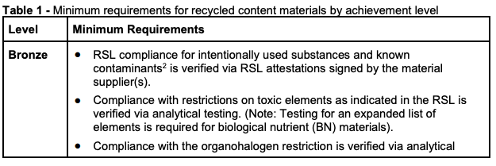
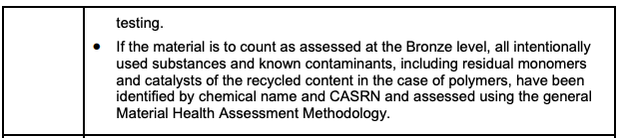
V4.0 RSL Compliance for Recycled Content Materials
See Recycled Content Materials Assessment Methodology, Table 1

Slide 21
Exposure Assessment Reminders
Please remember that the EAM, Appendix 2 only applies to professional use products, not products sold to consumers/general public.
If exposure to consumers may occur, use of PPE is not sufficient to conclude that exposure is controlled.
Example: Lime-based caulk mortar sold as a powder to consumers
Corrosive powder
PPE may be used to control professional use exposures, per Appendix 2B
But since the product is sold to consumers, Appendix 2B does not apply.

Slide 22
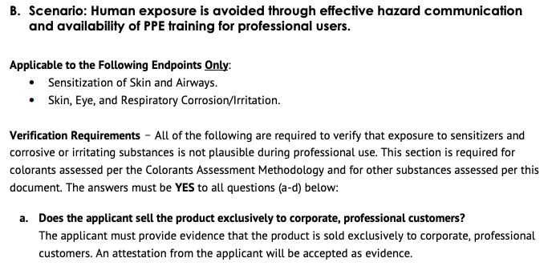
EAM, Appendix 2B

Slide 23
Open Discussion topics
UV Inks and Sensitization
Azo Dyestuffs vs Azo Pigments

Slide 24
Open Discussion Topic #1: UV Inks and Sensitization
MHAM Section 2.3 (p. 14) includes the following statement that mentions UV inks:
Materials are assessed based on the final chemical state of all substances in the material. Because of this, it is important to have an in-depth understanding of the key chemical reactions taking place and whether the chemical is still in its original form after curing or other reactions reach equilibrium. For example, UV inks contain several sensitizing and reactive chemicals in their “raw” state, but after the printing process is complete and the ink has cured, many of those substances are no longer present in their original state but rather have reacted to form a different molecular structure.
This section is intended to provide an example of a situation where material processing may affect the substances present in the material. It should not be interpreted to waive the hazards of sensitizers present in UV inks that undergo curing.
Discussion:
Is this consistent with how assessors have interpreted this section in the past?
For assessors who regularly complete this type of testing, have sensitizers been detected? Are there situations where curing does not completely remove the hazard?

Slide 25
Open Discussion Topic #2: Azo Dyestuffs vs Azo Pigments
Based on the Colorants Assessment Methodology (CAM), azo dyestuffs must be evaluated for their potential to cleave carcinogenic aromatic amines (3.5.3). Have any assessors evaluated a product that contained an azo dye and found that cleavage was not possible? If so, how was the chemical assessed?
As follow-up, have any assessors considered whether azo pigments should be subject to the same requirements? (CAM, Section 4.3.1) Currently, 4.3.1 states that products with azo pigments greater than 100 ppm cannot achieve higher than Bronze.

Slide 26
(If time) Other topics for open discussion
Requests for topics at June MH call?
Is anybody willing to present a topic/case study at the June MH call?

Slide 27
Thank you!!
Thank you very much for attending and for your contributions to the meeting.
These slides will be shared with the group.
Please be thinking about discussion topics for the next meeting, and reach out to me if you would be willing to present at a future meeting.
Enjoy the warmer weather – summer will be here soon!

