Slide 1
Comply with the Ecodesign for Sustainable Products Regulation (ESPR) with Cradle to
Cradle Certified®

Slide 2
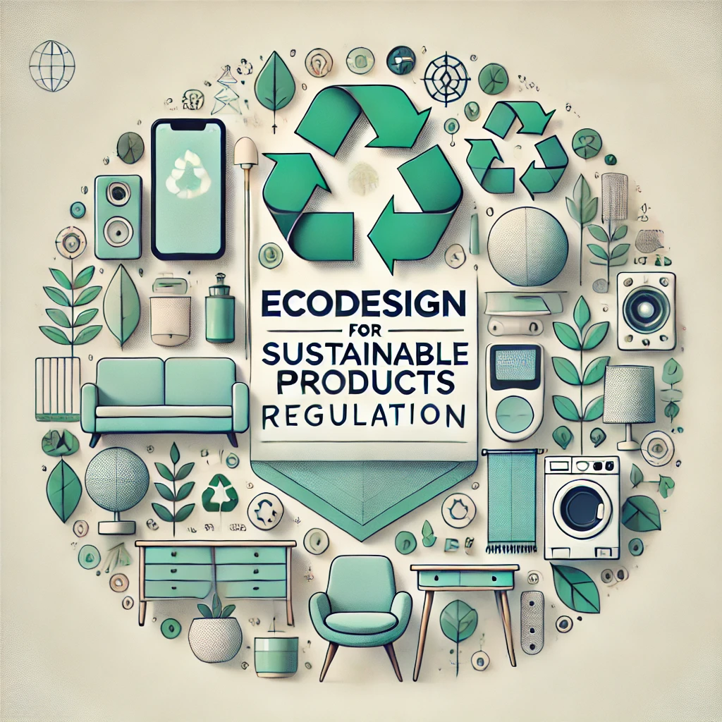
The Ecodesign for Sustainable Products Regulation (ESPR)
Central to achieving the objectives of the 2020 Circular Economy Action Plan
This Regulation aims to significantly improve the circularity, energy performance and other environmental sustainability aspects of products placed on the EU market.
A sustainable product typically exhibit some of these traits:
  Uses less energy
  Lasts longer
  Can be easily repaired
  Parts can be easily disassembled and put to further use
  Contains fewer substances of concern
  Can be easily recycled
  Contains more recycled content
  Has a lower carbon and environmental footprint over its lifecycle

Slide 3
The timeline
First ESPR working Plan expected to be adopted by the European Commission to cover a minimum of 3 years.
July 2024
Q1 2026
Textile Digital Product Passport expected to be adopted.
The new Ecodesign for Sustainable Products Regulation (ESPR) is adopted.
Q1 2025
First ESPR delegated act expected to be adopted for textiles and steel to estasblish market-entry requirements.
From Q1 2028

Slide 4
Prioritized products listed in ESPR first Working Plan
Intermediate products
Final products
Iron & Steel
Chemicals
Aluminium
Textiles (garments and footwear)
Furniture & Mattresses
Energy-related products (including new measures and revisions of existing ones)
Paints
Information and Communication Technologies (ICT)
Tyres
Detergents
Lubricants

Slide 5
Other key measures part of the ESPR
Digital identity card for products, components and materials that:
Stores relevant information
Promotes circularity
Strenghtens legal compliance
Digital Product Passport
First measures to ban the destruction of unsold textiles and footwear. Similar bans are expected to come in other sectors.
Transparency requirements for companies choosing to discard unsold articles (number and weight of products and reasons for discarding them).
Rules to address the destruction of unsold products
x
Mandatory Green Public Procurement criteria set for EU authorities who purchase regulated products.
Green Public Procurement
Notes:
Rules on the destruction of unsold consumer products goods
Many unsold products in the EU are simply destroyed, a practice that wastes valuable resources. For the first time in the EU, the ESPR introduces measures to address this practice, by introducing a ban on the destruction of unsold textiles and footwear, and opening the way for similar bans in other sectors, if evidence shows they are needed.
It will require large and eventually medium-sized companies across all product sectors to disclose annual information on their website, such as the number and weight of products they discard, as well as their reasons for doing so.
The adoption of the first rules to operationalise measures on the destruction of unsold consumer products goods will happen in 2025: includes setting a reporting format for the transparency requirements, and defining relevant exemptions to the ban on the destruction of textiles and footwear laid down under the ESPR.
Digital Product Passport
The ESPR will introduce a Digital Product Passport (DPP), a digital identity card for products, components, and materials, which will store relevant information to support products’ sustainability, promote their circularity and strengthen legal compliance.
This information will be accessible electronically, making it easier for consumers, manufacturers, and authorities to make more informed decisions related to sustainability, circularity and regulatory compliance. It will allow custom authorities to perform automatic checks on the existence and authenticity of the DPPs of imported products.
Information to be included in the DPP will be identified by the Commission, in close consultation with all relevant stakeholders, and will depend on the specific product in question. This information can include:
Product’s technical performance
Materials and their origins
Repair activities
Recycling capabilities
Lifecycle environmental impacts
Green Public Procurement
Public authorities in the EU spend around €1.8 trillion purchasing works, goods and services.
The ESPR will help steer these funds in a more sustainable direction, by enabling mandatory Green Public Procurement criteria to be set for EU authorities who purchase the products that it will regulate.
This has the potential to significantly boost demand for sustainable products, in turn, further incentivising companies to invest in this area.

Slide 6
Mandatory Green Public Procurement
Products excluded from the market
Mandatory EU GPP
To incentivize the supply and demand for environmentally sustainable products covered by ecodesign requirements
Based on the two highest performance classes
Ecodesign requirements
Lowest Performance
Classes of performance
Highest Performance
Min performance requirements

Slide 7
This document explains in detail how C2C Certified® goes beyond the ESPR requirements and is an ongoing incentive for companies to achieve excellence in the field of circularity.

Slide 8
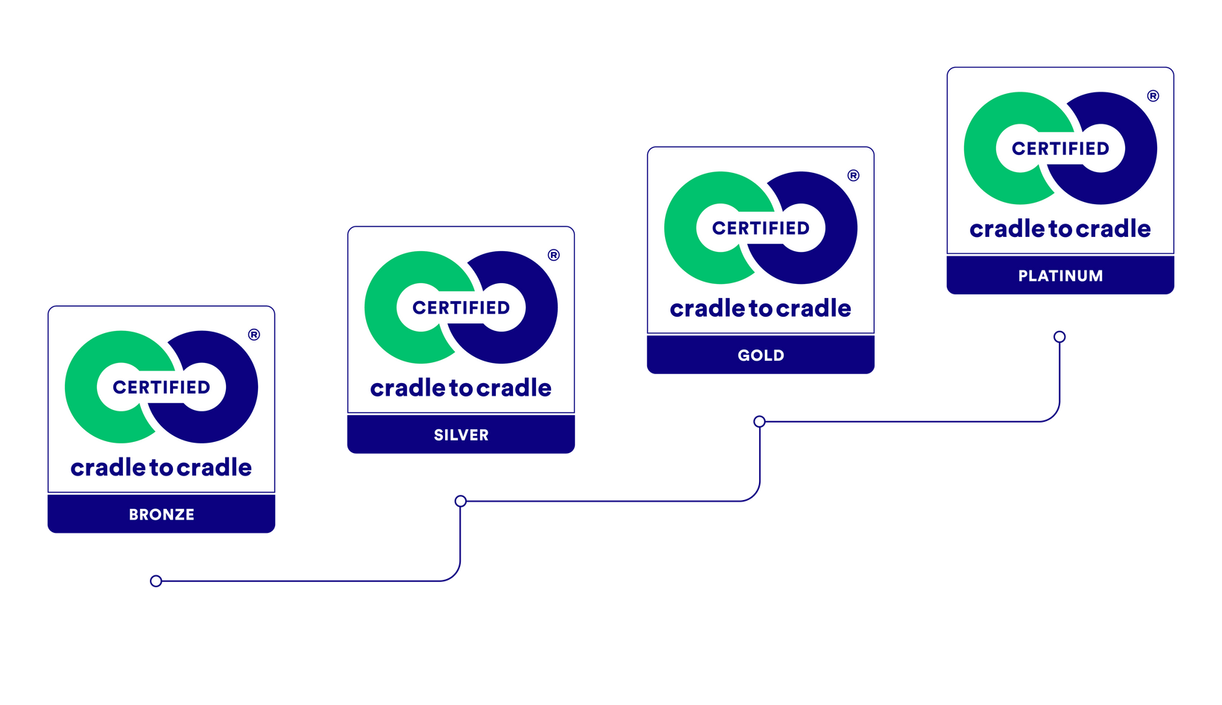
C2C Certified® to demonstrate compliance and beyond
ESPR requirements are the baseline of C2C Certified®.
C2C Certified® goes further through developing continuous improvement strategies for their products or by setting clear thresholds.
C2C Certified® is an ongoing incentive for companies to achieve excellence in the field of circularity. It helps to be future ESRP compliant when the sector-specific delegated acts will be published in the coming years.
It considerably reduces the burden of the compliance team, while ensuring that the products designed remain innovative.
Notes:
Market entry legislation
C2C Certified® requirements go further than what is expected, e.g. through developing continuous improvement strategies for their products or by setting clear thresholds.
The logic of C2C Certified® for product circularity aligns and exceeds the expectations of the PEF and the ESPR. C2C Certified® is an ongoing incentive for companies to achieve excellence in the field of circularity. It helps to be future ESRP compliant when the sector-specific delegated acts will be published in the coming years.
C2C Certified® certification process already requires all relevant documentation to ensure the requirements of the ESPR are met. It allows for the compliance team to release significant burden while making sure the products sold stay innovative.

Slide 9

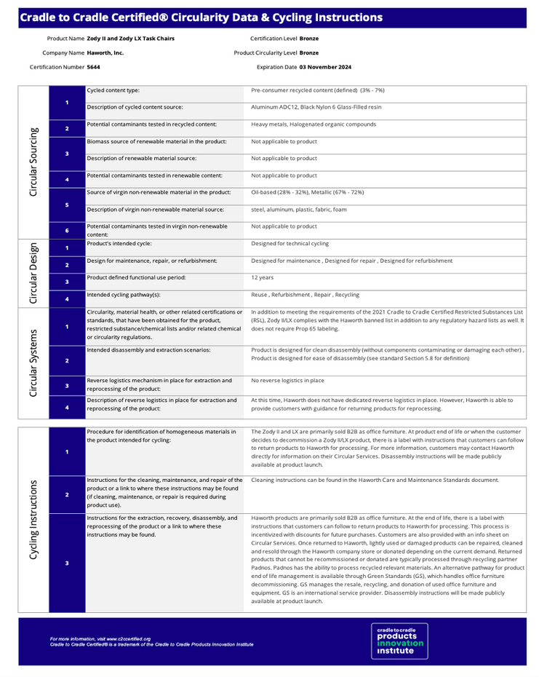

Circularity Data Report
Publicly available on the Product Registry
Ahead of the Digital Product Passport
Circularity attributes
Cycling instructions

Slide 10
Main divergences
C2C Certified® allows for different routes for circularity (biological or technical cycle) while the ESPR is more prescriptive in pointing for a specific route for specific product categories.
ESPR will require companies to publicly disclose substances of concern throughout a product’s lifecycle while C2C Certified® requires companies to identify substances of concern but not to disclose them publicly. This point will be further detailed in the delegated acts and the substances of concern that need to be published indicated.
The scope of C2C Certified® varies according to the requirement and the level of achievement. For certain requirements at lower achievement levels, the scope of C2C Certified® includes the applicant company and final manufacturing stage, while at the Gold and Platinum levels it mainly covers the entire supply chain, such as the ESPR.
Cycling pathways
Disclosure of substances of concern
Value chain
Notes:
The following slides showcase what will be presented in the document.

Slide 11
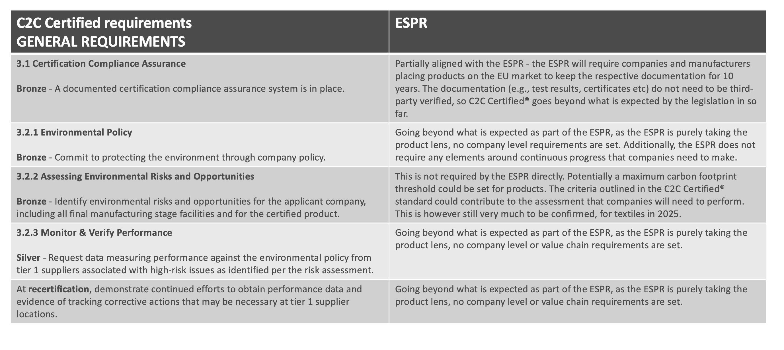
Detailed comparison of C2C Certified® with ESPR requirements
In the tables below, the left-hand column summarizes the C2C Certified® requirements, while the right-hand column explains what is required under the ESPR to implement.

Slide 12
C2C Certified requirements ENVIRONMENTAL POLICY & MANAGEMENT | ESPR
3.1 Certification Compliance Assurance Bronze - A documented certification compliance assurance system is in place. | Partially aligned with the ESPR - the ESPR will require companies and manufacturers placing products on the EU market to keep the respective documentation for 10 years. The documentation (e.g., test results, certificates etc) do not need to be third-party verified, so C2C Certified® goes beyond what is expected by the legislation in so far.
3.2.1 Environmental Policy Bronze - Commit to protecting the environment through company policy. | This is not required by the ESPR directly. Potentially a maximum carbon footprint threshold could be set for products. The criteria outlined in the C2C Certified® standard could contribute to the assessment that companies will need to perform. This is however still very much to be confirmed, for textiles in 2025.
3.2.2 Assessing Environmental Risks and Opportunities Bronze - Identify environmental risks and opportunities for the applicant company, including all final manufacturing stage facilities and for the certified product. | This is not required by the ESPR directly. Potentially a maximum carbon footprint threshold could be set for products. The criteria outlined in the C2C Certified® standard could contribute to the assessment that companies will need to perform. This is however still very much to be confirmed, for textiles in 2025.
3.2.3 Monitor & Verify Performance Silver - Request data measuring performance against the environmental policy from tier 1 suppliers associated with high-risk issues as identified per the risk assessment. | Going beyond what is expected as part of the ESPR, as the ESPR is purely taking the product lens, no company level or value chain requirements are set.
At recertification, demonstrate continued efforts to obtain performance data and evidence of tracking corrective actions that may be necessary at tier 1 supplier locations. | Going beyond what is expected as part of the ESPR, as the ESPR is purely taking the product lens, no company level or value chain requirements are set.

Slide 13
C2C Certified requirements ENVIRONMENTAL POLICY & MANAGEMENT | ESPR
3.2.4 Strategy for Environmental Policy Implementation Bronze - Develop a strategy for implementing the environmental policy and report on implementation progress at each recertification. | Going beyond what is expected as part of the ESPR, as the ESPR is purely taking the product lens, no company level or value chain requirements are set. Additionally, the ESPR does not require any elements around continuous improvement, meaning no corrective action plans need to be developed.
For recertification, environmental performance data must be collected and analyzed to measure progress toward achieving environmental targets and objectives, and areas for improvement must be identified. For any identified areas of poor performance, methods of improving outcomes must also be identified and evaluated and the strategy refined accordingly. | Going beyond what is expected as part of the ESPR, as the ESPR is purely taking the product lens, no company level or value chain requirements are set. Additionally, the ESPR does not require any elements around continuous improvement, meaning no corrective action plans need to be developed.
3.2.5 Demonstrating Commitment Bronze - Demonstrate commitment and support for establishing and maintaining a culture whereby employees and business partners are able to achieve high levels of environmental performance. | Going beyond what is expected as part of the ESPR, as the ESPR is purely taking the product lens, no company level or value chain requirements are set. No commitments on the value chain/ business partner performance need to be made.
3.2.6 Environmental Management Systems Silver - For the applicant company and for all final manufacturing stage facilities, implement management system(s) that support achievement of the environmental policy commitments within company and facility operations. | Going beyond what is expected as part of the ESPR, as the ESPR is purely taking the product lens, no company level or value chain requirements are set. No commitments on the value chain/ business partner performance or management systems need to be made.
Gold - Implement a responsible sourcing management system that supports achievement of the environmental policy commitments within the product’s supply chain. For recertification at the Silver or Gold level, the policy, procedures, practices and/or programs must be reviewed to identify deficiencies and implement changes (if needed) that will lead to improved performance. | Going beyond what is expected as part of the ESPR, as the ESPR is purely taking the product lens, no company level or value chain requirements are set. No commitments on the value chain/ business partner performance or management systems need to be made.

Slide 14
C2C Certified requirements ENVIRONMENTAL POLICY & MANAGEMENT | ESPR
3.2.7 Grievance Mechanisms Silver - Provide a grievance mechanism that permits stakeholders to obtain redress for negative environmental impacts. For any contract final manufacturing stage facilities, request that a grievance mechanism be made available. | Going beyond what is expected as part of the ESPR, as the ESPR is purely taking the product lens, no company level or value chain requirements are set. Any due diligence related requirements are out of the scope of the ESPR.
Gold - For contract final manufacturing stage facilities, ensure that a grievance mechanism is available that permits stakeholders to obtain redress for negative environmental impacts. | Going beyond what is expected as part of the ESPR, as the ESPR is purely taking the product lens, no company level or value chain requirements are set. Any due diligence related requirements are out of the scope of the ESPR.
3.2.8 Transparency and Stakeholder Engagement Silver - Use open and transparent governance and reporting, making information on how environmental risks are managed and adverse impacts are addressed publicly available. | Going beyond what is expected as part of the ESPR, as the ESPR is purely taking the product lens, no company level or value chain requirements are set. Any due diligence/general reporting related requirements are out of the scope of the ESPR.
3.2.8 Transparency and Stakeholder Engagement Gold - Incorporate stakeholder engagement and feedback into environmental risk management, using it to shape company strategy and operations. | Going beyond what is expected as part of the ESPR, as the ESPR is purely taking the product lens, no company level or value chain requirements are set. Any due diligence/general reporting related requirements are out of the scope of the ESPR.
3.2.9 Environmental Protection Incentives Platinum - Incorporate environmental performance results into relevant employee and executive performance evaluations and incentive structures. | Going beyond what is expected by the ESPR no company level requirements on the environmental performance/ due diligence practices are covered by the ESPR.
3.3 Measurable Improvement At recertification at the Bronze or Silver level, demonstrate that at least one measurable improvement has been made in at least one of the five program categories since the prior certification. | Going beyond as no improvement needs to be shown in order to be aligned with the ESPR. The ESPR only sets minimum requirements for products.

Slide 15
C2C Certified requirements MATERIAL HEALTH | ESPR
4.1 Compliance with Leading Chemical Regulations Bronze - The product complies with leading chemical regulations. | This neither aligns nor misaligns with the ESPR. Meeting the requirements of existing chemical legislation (REACH, RoHs etc) is a given to place products on EU markets.
4.2 Avoidance of Organohalogens and Functionally Related Chemical Classes of Concern Bronze - Homogeneous materials subject to review are not and do not contain organohalogen substances of special concern, or functionally related, non-halogenated substances of equivalent concern (i.e., per- and polyfluoroalkyl substances (PFASs), halogenated flame retardants (HFRs) and organophosphate ester flame retardants (OPFRs), halogenated polymers, halogenated organic solvents, and other highly halogenated, carbon-based materials) above relevant thresholds. Certain exemptions apply. | C2C Certified® restricts all REACH annex XVII and annex XIV listed substances and Persistent Organic Pollutants (POPs) already at the Bronze level. It also restricts PFASs, flame retardants and highly halogenated substances that are not regulated. This is going beyond what is required by the ESPR. If ESPR will include these substances under the specific product groups, there would be a requirement to disclose these substances (related to article 7 paragraph 5).
Silver - Homogeneous materials subject to review do not contain organohalogen substances in exceedance of 1% by weight. Certain exemptions apply. Gold - Homogeneous materials subject to review do not contain organohalogen substances above chemical subject to review limits (i.e., 100 ppm or lower if specific concentration limits are defined). | Category 1 and 2 Carcinogenic Mutagenic Reprotoxic (CMR) substances as defined per the CLP Regulation and substances of very high concern on the candidate list per REACH are restricted at the Silver level. This is going beyond what is required by the ESPR. All C2C Certified® Section 4.2 restrictions will also be restricted to the same extent per the ESPR (e.g., PVC and all other highly halogenated substances are highly restricted at Silver and fully restricted at Gold). However, if the ESPR will include these substances under the specific product groups, there would be a requirement to disclose these substances (related to article 7 paragraph 5). It is still unclear if thresholds (e.g., 1% by weight) will be set. Those should be defined per product group: e.g., textiles, toys, furniture etc.
Notes:
C2CC restricts all annex XIV listed substances and POPs already at Bronze level. Category 1 and 2 CMRs as defined per the CLP and substances of very high concern on the candidate list per REACH are restricted at Silver level. The remaining substances included in the definition will be for sure be restricted at Gold (or ealier if a substances of very high concern per REACH). This applies to chemicals in the product per the MH category and also to effluent/sludge per the WSS category which means C2CC is restricting these substances in process chemistry that is discharged to environment via effluent/sludge and in the product itself. At Platinum, other process chemistry that is not discharged to effluent/sludge is also in scope. There may be something I am not understand about the directive itself and/or the comment, but if I AM understanding I think this means the comments in the MH section can be stronger in support of C2CC. This seems to be an important point to get right for the analysis of the MH section overall.
The ESPR introduces specific requirements for so-called substances of concern (SoC). SoC cover the following:
A closed list of substances identified in other EU laws, that is, (1) substances of very high concern (SVHC) designated under REACH (Registration, Evaluation, Authorisation and Restriction of Chemicals), (2) substances that are classified under the harmonized classification of the Classification, Labelling and Packaging (CLP) Regulation, and (3) persistent organic pollutants (POPs) regulated under Regulation (EU) 2019/1021.

Slide 16
C2C Certified requirements MATERIAL HEALTH | ESPR
4.3 Material and Chemical Inventory Bronze - Characterize all homogeneous materials in the product by concentration and generic material type or category/name. In addition, fully define the chemical composition of products that are released directly into the biosphere as part of their intended use (e.g., soaps, paints). For other product types, collect the chemical composition information necessary to assess at least 75% of the product. | Directionally aligned with the ESPR, but going a step further as C2C Certified® requires to fully define the chemical composition of a product (or at least 75%), while the ESPR will likely be limited to substances of concern.
Silver - Fully define the chemical composition of products released directly into the biosphere as part of their intended use (e.g., soaps, paints). For other product types, collect the chemical composition information necessary to assess at least 95% of the product. | Directionally aligned with the ESPR, but going a step further as C2C Certified® requires to fully define the chemical composition of a product (or at least 95%), while the ESPR will likely be limited to substances of concern.
Gold - Fully define the chemical composition of all homogeneous materials subject to review within the product. | Directionally aligned with the ESPR, but going a step further as C2C Certified® requires to fully define the chemical composition of a product, while the ESPR will likely be limited to substances of concern.
Platinum - Fully define the chemical composition of all process chemistry that comes into contact with the product or its material constituents during the final manufacturing stage. | Directionally aligned with the ESPR, but going a step further as C2C Certified® requires to fully define the chemical composition of a product, while the ESPR will likely be limited to substances of concern.

Slide 17
C2C Certified requirements MATERIAL HEALTH | ESPR
4.4 Assessing Chemicals and Materials Bronze - Assess at least 75% of the product | While the ESPR does not require an assessment of all substances/chemicals used in a product, the biggest difference is the notion of "throughout the lifecycle of the product", as defined in the ESPR (art 5). Meaning if in the 25% unassessed chemicals and materials of the product such a substance would be found, the product would be found "non-compliant". However, note that the entire product, including the portion that is not assessed, must comply with leading regulations (e.g., REACH, RoHS, POPs directives) and with additional restrictions on PFASs, HFRs, OPFRs, and highly halogenated substances at the Bronze level.
Silver - Assess at least 95% of the product | While the ESPR does not require an assessment of all substances/chemicals used in a product, the biggest difference is the notion of "throughout the lifecycle of the product", as defined in the ESPR (art 5). Meaning if in the 5% unassessed chemicals and materials of the product such a substance would be found, the product would be found "non-compliant". However, note that Category 1 and 2 CMRs and all substances on the SVHC candidate list are restricted at Silver (in addition to bronze restrictions noted above), including in portions of the product that are not assessed.
Gold - Assess 100% of the product | The ESPR does not require an assessment of all substances/chemicals used in a product. This goes well beyond the requirements of the ESPR or regulations in general and will include obtaining an understanding of hazard and risks associated with all chemicals in the product.
Platinum - Assess 100% of the product AND all process chemistry that comes into contact with the product or its material constituents during the final manufacturing stage. | This is aligned and going beyond the ESPR requirement as it not only covers substances of concern but other substances as well and addresses the noting of throughout the lifecycle of the product in covering process chemistry.

Slide 18
C2C Certified requirements MATERIAL HEALTH | ESPR
4.5 Material Health Optimization Strategy Bronze - Develop a Material Health optimization strategy | This is going beyond the ESPR, as the ESPR does not require any improvement strategies, given that it is a market entry legislation (baseline requirements for companies to place a product on the market).
Recertification: Demonstrate progress toward achieving the Material Health optimization strategy at each recertification. | This is going beyond the ESPR, as the ESPR does not require any improvement strategies, given that it is a market entry legislation (baseline requirements for companies to place a product on the market).
4.6 Using Optimized Materials Silver - Use materials in the product that do not contain substances that are: ● Classified or listed as known or suspected to cause cancer, birth defects, genetic damage, reproductive harm (CMRs), or cause an equivalent level of concern, unless exposure to these substances during the product’s final manufacturing, use, and end-of-use is unlikely or expected to be negligible, or ● Listed as persistent, bioaccumulative, and toxic (PBTs) or very persistent and very bioaccumulative (vPvBs). | This is going beyond the ESPR requirements. Testing of recycled content will be likely a key topic of further discussion under the development of the Sector specific requirements.
Gold - Use materials that are assessed as compatible with human and environmental health according to the Cradle to Cradle Certified Material Health Assessment Methodology, including only A/a, B/b, and C/c assessed materials and chemicals in the product. Platinum - Use materials and process chemicals that are assessed as preferable for human and environmental health according to the Cradle to Cradle Certified Material Health Assessment Methodology, including > 50% A/a and B/b assessed materials and chemicals in the product (see “Determining Percentage Assessed” in Section 4.4), and only A/a, B/b, and C/c assessed process chemistry. | The Assessment Methodology covers the same list of substances that are classified under the harmonized classification of the Classification, Labelling and Packaging (CLP) Regulation and refers to the same designations, so this requirement is directionally aligned and goes beyond this. The reasoning for including substances of concern is to cover not only substances that impact human health (falling under REACH) but also those that have environmental concerns (e.g., in impacting recyclability of products).

Slide 19
C2C Certified requirements MATERIAL HEALTH | ESPR
4.7 Volatile Organic Compound (VOC) Emissions Silver - Products designed for permanent indoor use comply with leading standards that demonstrate low VOC emissions. Gold - Products designed for permanent indoor use comply with leading standards that demonstrate very low to no VOC emissions. | This is likely going beyond what will be required by the ESPR. Substances that have environmental concerns and have a negative impact on outdoor air quality might be covered by the ESPR in the future sector-specific delegated acts.
4.8 VOC Content Silver - For liquid, viscous, or aerosol consumer or construction products, limit volatile organic compound (VOC) content to low levels as established by leading standards. | This is likely going beyond what will be required by the ESPR. Substances that have environmental concerns and have a negative impact on outdoor air quality might be covered by the ESPR in the future sector-specific delegated acts.
4.9 Optimizing Chemistry in the Supply Chain Platinum - Address hazardous chemicals in the product supply chain | This is aligned with the ESPR, however the ESPR will only restrict the use of those hazardous substances that are found on the final product.
Platinum - Develop a strategy to further reduce hazardous chemical use and/or emissions in the supply chain. | This is going beyond what will be required by the ESPR as there is no notion of continuous improvement.
Platinum - Demonstrate progress toward achieving reductions at each recertification. | This is going beyond what will be required by the ESPR as there is no notion of continuous improvement.
Notes:
A closed list of substances identified in other EU laws, that is, (1) substances of very high concern (SVHC) designated under REACH (Registration, Evaluation, Authorisation and Restriction of Chemicals), (2) substances that are classified under the harmonized classification of the Classification, Labelling and Packaging (CLP) Regulation, and (3) persistent organic pollutants (POPs) regulated under Regulation (EU) 2019/1021.

Slide 20
C2C Certified requirements PRODUCT CIRCULARITY | ESPR
5.1 Defining the Product’s Technical and/or Biological Cycles Bronze - Designate all homogeneous materials subject to review in the product as being intended for technical and/or biological cycles and define the intended cycling pathway(s) for each material. For materials designated for technical cycles, recycling must be one intended cycling pathway. Platinum - Define at least two intended cycling pathway(s) for each homogeneous material subject to review in the product. | Aligned 1) ESPR could in the future limit the number of materials used in products. 2) ESPR is likely to require instructions on how to treat the product at the end of its life, that could be communicated through the DPP specifically. However, in term of approach the ESPR does not differentiate between cycling pathways.
5.2 Preparing for Active Cycling Bronze - Develop a cycling plan to address challenge(s) inhibiting development of the cycling infrastructure for the product at the end of its first use, and identify potential partners that are capable of recovering and processing the product. | Neither aligned or not aligned: the ESPR does not require businesses to set up recycling strategies etc, this is addressed separately through the Waste Framework Directive. However, it is relevant to note, that this is different for certain product groups depending on the applicable legislation (e.g., electronics or batteries which are outside of the ESPR but have separate product legislation).
Silver - Initiate partnerships for recovery and processing of the product according to its intended cycling pathway(s). If there is more than one intended pathway for individual materials, partnerships may focus on one of those pathways (e.g., reuse, repair, refurbish, remanufacture, or recycling for the technical cycle). If the product is intended for cycling via municipal systems, use materials that are compatible with those systems. | See previous note, waste management strategies are typically dealt with under waste legislation (Waste Framework Directive). However, the ESPR might set requirements to improve the recyclability of products. It is still to be defined how these requirements will look like.
Gold - Initiate partnership(s) for recovery and processing of the product according to all intended cycling pathway(s). For the Gold level, the Silver level requirements must be applied to all additional intended pathways (if any). | See previous note, waste management strategies are typically dealt with under waste legislation (Waste Framework Directive). However, the ESPR might set requirements to improve the recyclability of products. It is still to be defined how these requirements will look like.

Slide 21
C2C Certified requirements PRODUCT CIRCULARITY | ESPR
5.3 Increasing Demand: Incorporating Cycled and/or Renewable Content Bronze - For select commonly cycled product and material types, incorporate the required percentage of cycled and/or renewable content into the product using an approved method. | Likely a future requirement of the ESPR, to include recycled and/or renewable content in products. Specific thresholds have to be identified. The European Commission is eager to require post- consumer recycled content for textile products. Chain of Custody (CoC) systems will be required to ensure the materials comply with the requirements.
Silver - Incorporate a percentage of cycled and/or renewable content into the product equal to or greater than industry averages and/or consistent with common practice. | Going beyond the legislation, the legislation as a "market entry" legislation only sets a minimum requirement, progress plans and achieving "better than industry average" is not required.
Silver - Develop a plan for increasing the use of post-consumer recycled and/or responsibly sourced renewable content. | Going beyond the legislation, the legislation as a "market entry" legislation only sets a minimum requirement, progress plans and achieving "better than industry average" is not required.
Demonstrate progress toward increasing the use of post-consumer recycled and/or responsibly sourced renewable content at recertification. | Going beyond the legislation, the legislation as a "market entry" legislation only sets a minimum requirement, progress plans and achieving "better than industry average" is not required.
Gold - Incorporate a percentage of cycled and/or renewable content into the product that is consistent with industry leaders for the product type. Depending on material type, incorporate either post-consumer recycled or responsibly sourced renewable content. | Going beyond the legislation, the legislation as a "market entry" legislation only sets a minimum requirement, progress plans and being ”consistent with industry leaders" is not required.
Bronze - Alternatively, publicly disclose an explanation of the limitation(s) preventing achievement of the required minimums. | The ESPR might require the disclosure of recycled content as an information requirement under the DPP.

Slide 22
C2C Certified requirements PRODUCT CIRCULARITY | ESPR
5.3 Increasing Demand: Incorporating Cycled and/or Renewable Content For the Bronze, Silver and Gold levels: A feasibility analysis may be applied as an alternative to meeting required percentages of cycled and/or renewable content in any case where an applicant is unable to meet the required percentages, including post-consumer recycled and responsibly sourced content as relevant. This alternative may be used for one or more materials in a product and at any achievement level except for Platinum. Platinum - Incorporate the maximal technically feasible percentage of cycled and/or renewable content into the product. | Going beyond the legislation, the ESPR will consider trade-off (e.g., decreased durability of the product due to higher recycled content) as well as availability of recycled materials. However, the ESPR will not require individual companies to perform a feasibility analysis.
5.4 Material Compatibility for Technical and/or Biological Cycles Bronze, Silver, Gold, Platinum - For 50%/70%/90%/99% of the product by weight, incorporate materials that are compatible with the intended cycling pathway(s). | This requirement is going beyond legislation. It is important to note that the legislation does not differentiate between cycling paths, but overall requirement goes beyond what is required under the EU legislation.
5.5 Circularity Data and Cycling Instructions Bronze - Make data to support cycling of the product in its intended pathway(s) and instructions for how to cycle the product publicly available. | This is aligned with the DPP expectations, again those will be defined per product group as part of the delegated acts (to be defined for textiles in 2025).

Slide 23
C2C Certified requirements PRODUCT CIRCULARITY | ESPR
5.6 Circular Design Opportunities and Innovation Silver - Develop a plan for implementing a circular design opportunity or innovation that increases product circularity. | Going beyond the ESPR. As a "market entry legislation" the ESPR does not require companies to develop plans to continuously improve. Products that enter EU markets "simply" need to meet the requirements of the legislation (yes/no), companies are not required to go further than that or to continuously improve.
Demonstrate progress toward achieving the plan for implementing a circular design opportunity or innovation at recertification. | Going beyond the ESPR. As a "market entry legislation" the ESPR does not require companies to develop plans to continuously improve. Products that enter EU markets "simply" need to meet the requirements of the legislation (yes/no), companies are not required to go further than that or to continuously improve.
Gold - Implement a circular design opportunity or innovation. | The ESPR is more descriptive in terms of what is expected from products: e.g., minimal durability will be mandatorily set for some products. This requirement could be updated once there are more details on the ESPR when we have more details in the thresholds that will be set (for textiles in 2025).
5.7 Product Designed for Disassembly Silver - For products with multiple materials requiring separation for cycling in the intended pathway, develop a plan for increasing the ease of product disassembly into discrete materials for intended cycling pathway(s). Gold - For products with multiple materials requiring separation for cycling in the intended pathway, and for 90% of materials by weight, intentionally design the product for ease of disassembly. Platinum - For products with multiple materials requiring separation for cycling in the intended pathway, and for 99% of materials by weight, intentionally design the product for ease of disassembly. | As recyclability might be one of the potential performance requirements of the ESPR (art 6) this point of C2C Certified® might increase in relevance in this context. However, we will have to see for what product groups this will become essential (through the development of the Delegated Acts).

Slide 24
C2C Certified requirements PRODUCT CIRCULARITY | ESPR
5.8 Active Cycling Gold - For select single-use plastic products and single-use plastic packaging (when certified as a separate product), actively cycle ≥ 50% of the product’s materials and implement a program to increase the cycling rate or quality of the product for its next use. | Packaging is not covered under the ESPR but is covered through the Packaging and Packaging Waste Regulation (PPWR).
Gold - For other short-use phase products, and for any product that is required to be cycled per leading regulations (e.g., electronics, apparel), actively cycle at least some (> 0%) of the product’s materials and implement a program to increase the cycling rate or quality of the product for its next use. | Follows the logic of the ESPR with identifying trade-offs. It would be important to check the outcome of the ESPR Delegated Act for textiles end 2025.
Gold - For long-use phase products, actively cycle at least some (> 0%) of the product’s materials or implement a program to increase the cycling rate or quality of the product for its next use. | Follows the logic of the ESPR with identifying trade-offs. The legal framework of the ESPR does not yet specify the nature of the trade-offs: e.g., as in this case durability vs recyclability, but further down the line and per product group the idea would be to further define those trade-offs and how those can be tackled.
Platinum - For long-use phase products, actively cycle the product’s materials and implement a program to increase the cycling rate or quality of the product for its next use. | Neither aligned nor misaligned with the ESPR. The ESPR would likely not to go into this level of detail.
Platinum - Monitor cycling rates and quality over time, and demonstrate an increase in either cumulative cycling rate or quality. | Neither aligned nor misaligned with the ESPR. The ESPR would likely not to go into this level of detail.
Platinum - Actively cycle a minimum percentage of the product’s materials based on the duration of the product’s use phase. | Follows the logic of the ESPR with identifying trade-offs. It would be important to check the outcome of the ESPR Delegated Act for textiles end 2025.

Slide 25
LinkedIn
Instagram
Twitter
Newsletters
@CradletoCradleProductsInnovationInstitute
@c2ccertified
@c2ccertified
c2ccertified.org/subscribe

